Slide 1
BEYOND EFL TEACHING
THE ROLE OF A BUSINESS ENGLISH LECTURER
IN TERTIARY EDUCATION
as perceived by pre-service learners
and in-service users
CALPIU 2012
Jolanta Łącka-Badura and Magdalena Łęska
University of Economics, Katowice, Poland

Slide 2
POLISH UNIVERSITIES IN TRANSITION
ENGLISH ENGLISH
taught (mostly) used as a
as a separate medium
university subject of instruction
– ESP courses

Slide 3
AIMS
To capture the ‘transition period’
by investigating the current perceptions that Business English learners and users have of the roles to be perfomed by BE lecturers in university settings.

Slide 4
RESEARCH QUESTIONS
1. What model of Business English teacher and
his/her roles emerge from literature on
English for Specific Purposes (ESP)
and Content Based-Instruction (CBI)?
2. How do pre-service BE learners and job-
experienced BE users perceive the role of Business
English teacher in higher education?
3. To what degree are students’ perceptions and
expectations consistent with the model
recommended by CBI and ESP specialists ?

Slide 5
Content-Based Instruction
CBI
”implies the total integration of language learning and content learning. It represents a significant departure from traditional foreign language teaching methods in that language proficiency is achieved by shifting the focus of instruction from the learning of language per se to the learning of language through the study of the subject matter” (Stryker and Leaver, 1997: 3)

Slide 6
Content-Based Instruction
viewed from different perspectives
”CBI can be at once a philosophical orientation,
a methodological system, a syllabus design for a single course, or a framework for an entire program of instruction”.
(Stryker and Leaver, 1997: 5)

Slide 7
Content-Based Instruction
A CONTINUUM OF CONTENT AND LANGUAGE
INTEGRATION
Content-Driven <<< >>> Language-Driven
Total / Partial Sheltered Adjunct Theme-Based Language Immersion Courses Model Courses classes
with frequent
use of content

Slide 8
CBI and English for Specific Purposes
content - frequently used as the organizing
principle in a variety of ESL and ESP courses
(e.g. Grabe and Stoller, 1997; Richards and Rodgers, 2002)
successful outcomes of incorporating content-based instruction in ESP programs
Stryker and Leaver: LSP - one of the “most common models”
of Content-Based Instruction (1997: 3)
Kavaliauskiene: CBI - “an appealing approach to English for
Specific Purposes” (2004:1)
Master: ESP programs make “substantial use of the CBI
syllabus” (1997: 10)
Cianflone & Coppolino: didactic aims of ESP/EAP ”can be fostered
by content-based instruction (CBI)” (2009:1)

Slide 9
English for Specific Purposes
ESP
goal- and task-oriented
aimed primarily at adult learners
with the interaction between the teacher and learner often differing from that in general English classes.
“Absolute characteristics” of ESP:
designed to meet specific needs of the learner
makes use of the underlying methodology and activities of the disciplines it serves
centred on the language, skills, discourse, and genres appropriate to these activities
(Dudley-Evans and St John 1998: 4-5)

Slide 10
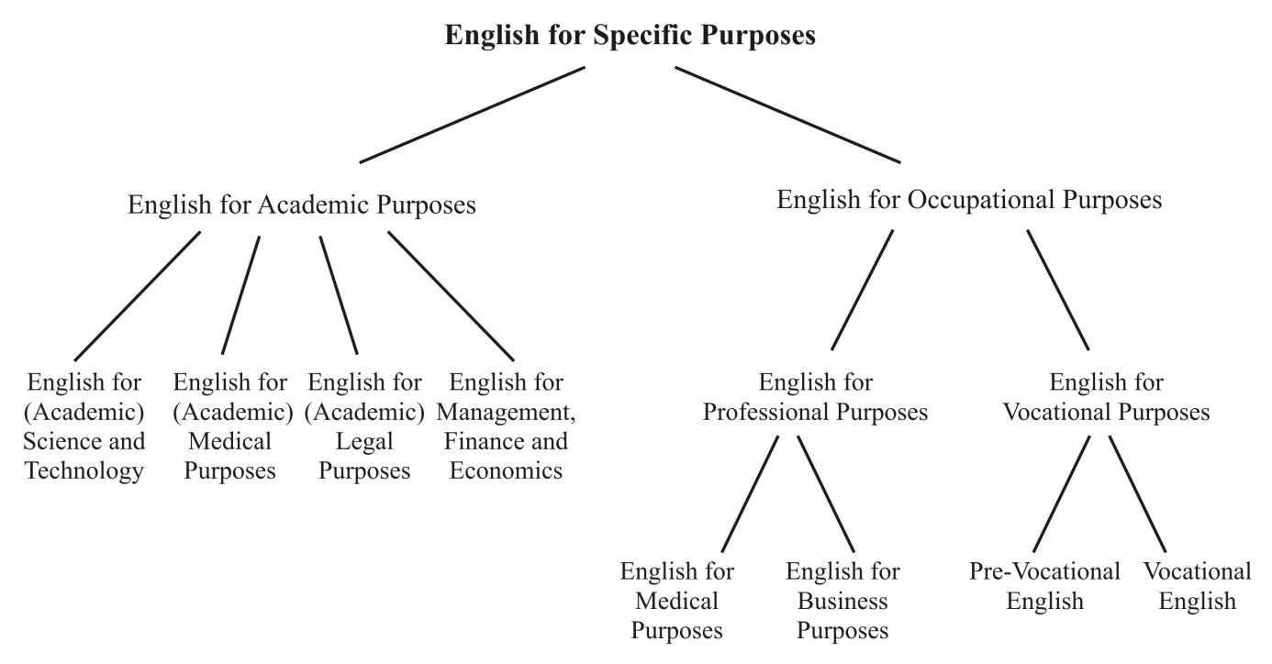

Slide 11
Business English
a medium of communication
within a company
between companies
with the public
(Pickett, in Dudley-Evans and St John, 1998)
language needed for knowing/ talking about
business (academic BE)
language needed for doing business
(BE for work)
(Strevens, 1977; Picket, 1988; Brieger, 1997, quoted in Nelson, 2000)

Slide 12
ROLES of the CBI practitioners
Stryker and Leaver: “a team teaching approach offers definite advantages”
IF language professionals take on a CBI course single-handedly, they
“must be more than just good language teachers”;
apart from being specialists in language teaching, they need to be
“knowledgeable in the subject matter and able to elicit that knowledge from their students”
(1997:292)

Slide 13
ROLES of CBI practitioners
in accordance with the principles of
Communicative Language Teaching
The CBI teacher:
facilitates the communication process between all students
acts as a counselor / independent participant within the learning-teaching group
analyses learners’ needs
exemplifies an effective communicator
acts as a group process manager who monitors, encourages, notes gaps in lexis, grammar and strategy but suppresses the inclination to fill those gaps
comments upon the gaps, points out to alternatives, and extensions, as well as assists the students in self-correction
implications for the role of learner
CONSCIOUS and AUTONOMOUS LEARNER
(Richards and Rogers, 2002)

Slide 14
ROLES of ESP practitioners
practitioner rather than teacher
ESP - “much more than teaching”
(Dudley-Evans and St John 1998:13)
ESP teaching
”increasingly seen as a means of acquiring professional expertise associated and integrated with the discursive practices of the workplace and professional cultures (…)”
(Bhatia, 2004:xii)

Slide 15
ROLES of ESP practitioners
Teacher - “not in a position of the ‘primary knower’ of the carrier content of the material”
Consultant/ Facilitator - flexible and open-minded, often accepting the position of a ‘co-learner’
Course designer and materials provider
Researcher- at least aware of the latest findings of research into ESP
Collaborator – involved in cooperation, collaboration or team-teaching with subject experts
Evaluator – of both students’ performance and the quality of courses and teaching materials
(Dudley-Evans and St John, 1998; Hutchinson and Waters, 1987)

Slide 16
Roles of a BE instructor
An ESP practitioner plus 3 additional qualities:
1) interested in and enthusiastic about
business-related issues
2) effective business communicator
3) must show an understanding of cross-
cultural issues
(Dudley-Evans and St John,1998)

Slide 17
The model of a BE practitioner
Language provider (using teaching strategies in line with the Communicative Language Teaching)
Content provider (knowledgeable in the subject matter and able to elicit that knowledge; at least generally familiar with, interested in and enthusiastic about business related and cross-cultural issues)
Enthusiastic content learner (comfortable with drawing on learners’ specialist content knowledge)
Effective business communicator (responsible for developing students’ Business English ‘soft skills’ and overall communicative competence)
Collaborator (engaged in various forms of cooperation with business specialists/ teachers)
Course programmer / designer (ideally not
designing the course around any coursebook)

Slide 18
The model of a BE practitioner
Materials provider (selecting and adapting authentic materials to students’ specific needs)
Class manager / consultant / facilitator rather than the ‘teller’, ‘primary knower’, ‘controller’
Learning trainer (helping students build their autonomy and develop effective learning strategies)
Creator of learner-centered classroom
Evaluator of language performance, but also (certain aspects of ) content
Researcher (even if not actively involved in research projects, at least aware of and in touch with research in the subject area)

Slide 19
A Business English teacher and her/his role in academic education THE SURVEY
How do pre-service learners
and job-experienced users
perceive the role of
the Business English teacher
in higher education?

Slide 20
A Business English teacher and her/his role in academic education – THE SURVEY
Part 1 (12 questions) - information about respondents
language competence
participation in an academic Business English course
current and future use of English at work
Part 2 (5 questions) - the Business English lecturer
professional competence, including content knowledge and business communication
classroom presence
materials development
Part 3 (16 questions) - the Business English classroom
homework
error correction
testing
the use of course books
Part 4 (3 questions) – a Business English course in university curriculum
composition
formula

Slide 21
A Business English teacher and her/his role in academic education – RESPONDENTS
University of Economics in Katowice, Poland
undergraduate students (116)
master’s students (47)
graduates (65)
University of Applied Sciences Wiener Neustadt for Business and Engineering, Austria
undergraduate and postgraduate students (66)

Slide 22
The survey - Part 2 University Business English teacher
RESULTS
A Business English teacher emerges as:
a content provider
a language instructor
an evaluator
an effective business communicator
a creator of learner-centered classroom
a materials provider

Slide 23
The survey - Part 2 University Business English teacher
Question 1
A Business English teacher and his/her knowledge of business terms and concepts
G1 G2 G3 Au
A teacher gives detailed explanations of business issues, including examples and real-life situations. | 33.0 60.9 32.8 | 62.1
A teacher doesn’t have to be an expert, but she/he must be familiar with general business issues. | 41.7 26.1 43.8 | 24.2
A Business English teacher should be like a General English teacher, she/he just knows more words about business. | 25.2 10.9 23.4 | 13.6

Slide 24
The survey - Part 2 University Business English teacher
Question 2
Case studies, problem solving tasks, business role plays
G1 G2 G3 Au
While doing business case studies and simulations, a teacher provides both language correction and evaluates business solutions proposed by students. | 60.0 39.1 31.3 | 54.5
When we participate in business role plays, there is language correction and some discussion with the teacher on the outcome of the task performed. | 31.3 52.2 59.4 | 25.8
After we do problem solving tasks, a teacher provides language feedback, but we don’t discuss and asses business solutions to the tasks. | 8.7 6.5 9.4 | 15.2

Slide 25
The survey - Part 2 University Business English teacher
Question 3
Soft skills (interpersonal communication, presenting, negotiating, etc.)
G1 G2 G3 Au
A teacher develops my soft skills both by providing and evaluating language and by discussing my behaviour in a given situation and how effective this behaviour was. | 53.9 47.8 45.3 | 43.9
A teacher explains the importance of soft skills in business communication, but the evaluation of business communicative tasks focuses on language behaviour, not on communicative behaviour. | 37.4 41.3 39.1 | 31.8
The role of a Business English teacher is not to teach us soft skills, but develop our language competence. | 7.8 8.7 15.6 | 18.2

Slide 26
The survey - Part 2 University Business English teacher
Question 4
Business English teacher classroom presence
G1 G2 G3 Au
A teacher offers space where learning can happen – distributes tasks, monitors time, makes sure everybody has a chance to contribute. | 61.7 56.5 59.4 | 71.2
A teacher is like a manager who delegates tasks and gives assignments and later holds students accountable for their execution. | 7.8 13.0 14.1 | 7.6
A teacher acts as an instructor, presenting the target language and providing clear and drill-like exercises, and evaluator, regularly testing students’ progress. | 30.4 28.3 25.0 | 15.2

Slide 27
The survey - Part 2 University Business English teacher
Question 5
Teaching materials – reading and listening texts, speaking tasks, case studies
G1 G2 G3 Au
A teacher creates teaching materials as tasks such as discussion questions, simulations, role plays, while students work on new language themselves, using dictionaries and Internet resources. | 20.9 26.1 21.9 | 12.1
A teacher creates teaching materials both as tasks such as discussion questions, simulations, role plays, and as language exercises which focus on vocabulary and grammar building. | 61.7 63.0 64.1 | 77.3
A teacher creates teaching materials which, first of all, teach students new vocabulary and grammar. | 17.4 8.7 12.5 | 4.5

Slide 28
The survey - Part 3 University Business English classroom
RESULTS
A Business English teacher emerges as:
an evaluator
a creator of learner-centered classroom
a consultant
a course designer

Slide 29
The survey - Part 3 University Business English classroom
Evaluator
G1 G2 G3 Au
regular feedback following the completion of a particular project or modules | 80.2 89.3 84.6 | 92.4
immediate correction of mistakes made by individual learners | 93.1 82.7 87.5 | 81.5
feedback involving both language learning progress and content knowledge | 48.7 63.0 53.2 | 81.9
focus on accuracy during the testing process | 55.7 63.1 51.6 | 50.0
error correction and feedback as necessary elements of productive tasks (speaking and writing) | 69.5 84.8 86.0 | 87.9
feedback on the effectiveness of communication | 82.6 80.4 86.0 | 66.6

Slide 30
The survey - Part 4 Business English course in university curriculum

Slide 31
Business English course in university curriculum

Slide 32
REFERENCES:
Bhatia, V.K., 2004. Worlds of Written Discourse. London/New York: Continuum.
Brinton, D.M., M.A. Snow and M.B. Wesche, 1989. Content-Based Second Language Instruction. New York: Newbury House.
Brinton, D.M. (2007). “Content-based instruction: Reflecting on its applicability to the teaching of Korean”. Presented at the 12th
Annual Conference American Association of Teachers of Korean Chicago, Illinois. 14th-16th June, 2007. Available at
http://www.aatk.org/www/html/conference2007/pdf/Donna%20Brinton.pdf . Accessed 19 March, 2012.
Cianflone, E. and R. Coppolino, 2009. “English for Specific Purposes and Content Teacher Collaboration: Report on a Pilot Project”.
English for Specific Purposes, Vol. 8, Issue 3(24). Available at:
http://www.esp-world.info/Articles_24/Cianflone%20&%20Coppolino.pdf . Accessed 19 March, 2012.
Dudley-Evans, T. and M. J. St John, 1998. Developments in ESP. A multi-disciplinary approach. Cambridge: Cambridge University Press.
Dudley-Evans, T., 2000. “Genre analysis: a key to a theory of ESP?”. IBERICA, 2. Pp.: 3-11.
http://www.aelfe.org/documents/text2-Dudley.pdf . Accessed 3 October, 2011.
Grabe, W. and F.L. Stoller, 1997. “Content-based Instruction: Research Foundations”. In M. A. Snow, & D. M. Brinton (Eds.),
The Content- Based Classroom: Perspectives on Integrating Language and Content. New York: Longman. Pp.: 5–21.
Hutchinson, T. and A. Waters, 1993. English for Specific Purposes. A learning-centred approach. Cambridge: Cambridge
University Press.
Kavaliauskiene, G., 2004. “Research into the Integration of Content-based Instruction into the ESP Classroom”. Journal of Language
and Learning, Vol. 2, No. 1. Pp.: 1-12.
Master, P., 1997. “Content-Based Instruction vs. ESP”. TESOL Matters Vol. 7, No. 6. P. 10.
Met, M., 1999. “Content-based Instruction: Defining Terms, making Decisions.” The National Foreign Language Center: Center for
Advanced Research on Language Acquisition. Available at http://www.carla.umn.edu/cobaltt/modules/principles/decisions.html.
Accessed 11 November, 2011.
Nelson, M. (2000). A Corpus-based study of the lexis of Business English and Business English teaching materials. Unpublished thesis.
University of Manchester. Manchester. Available at http://users.utu.fi/micnel/thesis.html. Accessed 23 February, 2012.
Richards, J.C. and T.S. Rodgers, 2002. Approaches and Methods in Language Teaching (2nd edition). Cambridge: Cambridge
University Press.
Savaş, B. 2009. “Role of Functional Academic Literacy in ESP Teaching: ESP Teacher Training in Turkey for Sustainable Development”.
The Journal of International Social Research, Vol. 2, No. 9. Pp.: 395-406.
Sobkowiak, P. 2008. Issues in ESP: Designing a Model for Teaching English for Business Purposes. Poznań: Wydawnictwo Naukowe UAM.
Stryker, S.B. and B. L. Leaver (eds), 1997. Content-Based Instruction in Foreign
Language Education: Models and Methods. Washington D.C.: Georgetown University Press.

Slide 33
TAK
THANK YOU
DZIĘKUJEMY

