Slide 1
Languages and policies at the University of Helsinki
Jan K. Lindström
Round Table, CALPIU’12, Roskilde, April 4, 2012
Higher education across borders:
Transcultural interaction and linguistic diversity

Slide 2
Finland A state with two national languages
Finland as a part of Swedish kingdom (12-14th century) to 1809
Swedish as a national language, Finnish as a language of the (majority of) population esp. in interior parts of Finland
Swedish as a language of administration, higher education, the elite, the privileged, …
1809-1917: Finland as a part of the Russian empire as an autonomous Grand Duchy
Preserves (Swedish) language rights and legal system
Swedish continued to dominate until the beginning of the 20th century in administration and higher education
Finland declares independency in 1917
Constitution: Finland and Swedish co-official languages
Language Act defining language rights
Cultural but not territorial autonomy for ”Swedophones” (except Åland)

Slide 3
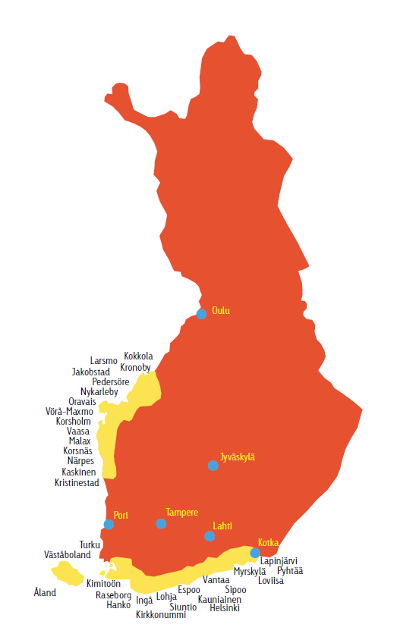
The Swedish-speaking population in Finland
2010: 291 153 (5,4 %)
Out of a total pop. of ca 5 M
http://www.folktinget.fi/Site/Widget/Editor/137/files/SVENSK_i_FINLAND_ENGLISH_A4_WEB.pdf

Slide 4
Helsinki - Helsingfors A bilingual university
The first and biggest university
est. 1640; 36,000 students; 8,600 staff
A national symbol mirroring a bilingual society
6 % Helsinki Swedish / Swedish-speaking students
Defined as bilingual in the University Act
Finnish and Swedish are languages of instruction
Finnish is the language of administration (defined in the administrative regulations of UHE)
Trilingual laguage policy document 2007

Slide 5
What is ”bilingualism”
Means the promotion of Swedish mainly in instruction and through some internal economic support
Monolingual solutions in Finnish and Swedish
Specifically Swedish units
Swedish School of Social Sciences
Specifically Swedish subjects
Philosophy, history, Scandinavian lgs & literature
Specifically Swedish quotas and instruction
Medicine, law, ..
Since 2010 a few experiments with parallel Swedish-Finnish education/programs

Slide 6
English at the university Ambivalence and ambiguity
The status of English is unquestioned as the language of science and internationalization
”National sciences” struggle against the trend
English master’s programs have been introduced for the recruitment of foreign students
Segregation of national and international students
English as a threat to bilingualism
May replace the minority language (Swedish)
English is no vehicle for internal administration
Segregation of the national and the international
Demand of English has started a development towards trilingualism
What language does/may ”cost”?

Slide 7
Tensions between policy and practice
De jure: omnipresent and functional bilingualism
De facto: uneven distribution of Swedish functions and competences; English dominates in certain fields; Finnish has an omnipresent overall dominance
De jure: English is supported as the third academic language
De facto: English is marginal in many faculties and fields
De jure: services for Swedish speakers and foreign students and staff should be provided
De jure and de facto: Finnish is the language of administration

Slide 8
Signage Official and unofficial

Slide 9
Outlook
A well-meaning language policy must be connected to action programmes with a vision of intended outcomes
What is to be achieved?
Attitude improvement
Opportunity creation for more multilingualism...
Competence development
No resource expansion in sight: Who wins, who loses?
Meet the interests of society and a linguistic-cultural minority
Meet the challenges of national and international competition
”internationalization” as a governmental performance measurement factor

