Slide 1
“I did speak Spanglish for a long time, and that was a bad thing”: How the use of Spanish and English shaped the life experiences of a return migrant and his perceptions of academic success in Puerto Rico
CALPIU 2012
Lisa Ortiz
MAEE Candidate, University of Puerto Rico, Mayagüez
Centro para la investigación del bilingüismo y aprendizaje

Slide 2
Thesis Project
El inglés es la clave: Life Histories of First-Generation-College-Student Return Migrants and Their Perceptions of English as Key to College and Professional Success

Slide 3
UPRM: A bilingual university?
No official documentation.
Law approved in 1993 which reinstated English as one of the official languages (alongside Spanish) in Puerto Rico
Academic offerings at UPRM are the same as the majority of K-12 public schools.
Textbooks are often in English, lectures and discussions in Spanish
Spanish for formal means of communication and social interactions
However, bilingualism is formally endorsed by the fact that students are required to study English. Students must register in and approve a minimum of 12 credits in English
Notes:
This may give the impression that Spanish and English evenly and fluently co-exist in all institutional operations, including the classroom.
It is well known by University community members that, excluding courses of the Department of English and those offered by professors who are unable or choose not to communicate in Spanish, courses are taught predominantly in Español.

Slide 4
English Prestige in Puerto Rico
“A better knowledge of English is considered the key to future success. Mobility in society and the professional arena has become a motivation for teaching and learning English in Puerto Rico”
Norman Maldonado (2000)
Former president of the University of Puerto Rico

Slide 5
English Prestige in Puerto Rico
 |  |  |  | $$ Success Higher Social Status Capital
 |  | Better Employment Opportunities
English Knowledge

Slide 6
Bourdieu’s Theory
Symbolic Capital Institutionally recognised and legitimated authority and entitlement requisite for the exchange and conversion of Cultural, Economic and Social Capital
Cultural Capital | Embodied Capital | Knowledges, skills, dispositions, linguistic practices and representational resources of the bodily habitus
 | Objectified Capital | Cultural goods, texts, material objects and media physically transmissible to others
 | Institutional Capital | Academic qualifications, awards, professional certificates and credentials
Economic Capital | Material goods and resources directly convertible into money
Social Capital | Access to cultural and subcultural institutions, social relations and practices
Types of capital. Source: Luke, in press

Slide 7
The path towards capital: Migration

Slide 8
Return Migration
Each main current of migration produces a compensating counter-current (Duany, 2002)
Movement
Employment
English(?)
Accumulation of Capitals(?)

Slide 9
“
Much of my story does revolve around language. It’s always been this language deal with me. Many of the choices that I have made have had to do with language
”

Slide 10
Life Histories
“The recording of personal testimony delivered in oral form”. Used interchangeably with oral history, self-report, memoir, testament, etc. (Yow 2005, p. 3)
One of the distinguishing traits of oral history is that “it tells us less about events than about their meaning” (Portelli 2006, p. 36).
“Life history grounds these stories of personal experience in their wider social and historical context, and pays attention to social relations of power” (Bathmaker 2010, p. 2).
Notes:
The rise of oral history in the United States dates back to the 1920s and
although its interest declined due to doubts of validity (Goodson, 2001), by the 1960s “an interest in recording the memories of people other than elites became paramount among academics” (Yow, 2005, p. 3).
These memories can be part of stories that are too part of a larger life history (Goodson 2001).
For the purposes of my thesis project, I follow this definition; I believe that it fits properly since many were the stories that marked each narrator’s life history.

Slide 11
Whose Life?
First Generation College Student
Return Migrant
Return Migrant
English Proficient
Puerto Rico
First Generation College Student
(Engle, 2006)
Indicator of Social Class
Notes:
Many jobs/ educational changes

Slide 12
Sunny
Early 30s
The perennial student
Loves making friends although he doesn’t “know how to really keep the contact today”
Likes being alone
Son of returners
Studied in K-12 public schools in Chicago and Puerto Rico
Studied in private and public universities in Puerto Rico
Notes:
Many jobs/ educational changes

Slide 13
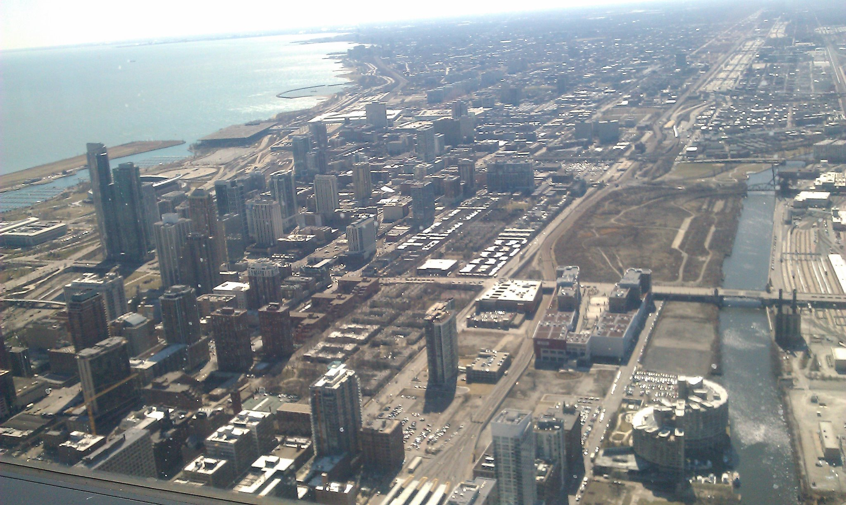
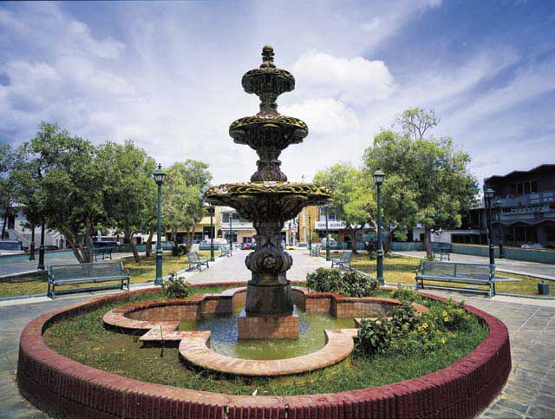
Sunny
Moved to rural area in Camuy, Puerto Rico in 1991 at the age of 13.
Born in Chicago, Illinois in 1977 and lived in the suburbs.

Slide 14
Identity
Name change from Spanish to English at home and in school
Being Puerto Rican
“Being an English speaker pulled me more into being an American and less being Puerto Rican when I was over there (Chicago). The way I saw it was that being Puerto Rican was for older people. When I moved to the island, I didn’t see it that way anymore”
“I think I consider myself Puerto Rican. Yeah, I think because in Chicago I was very discriminated for being Hispanic”
Pride in his patria (homeland)

Slide 15
Language Learning
Learned English in school where Spanish could not be spoken.
Could understand Spanish but probably not speak it or read it very well.
Considers having been raised bilingual because grandmother (caregiver) did not know English.

Slide 16
Language in Higher Ed Process
Scores on the College Entrance Examination Board were low due to language, preventing Sunny to be admitted to the UPRM
(Scores) “in Spanish were so low that even though I did improve a lot in High School with my Spanish; it wasn’t good enough for University”.

Slide 17
Language in Higher Ed Process
Upon starting college
“My Spanish was very poor still, even though I was able to write and read. I was a functional illiterate. I could read but I didn’t understand half the things I was reading. My English, well, it kind of stayed in this eighth grade bubble”
“It was like to be proficient in English was to be deficient in Spanish. I really didn’t have a balance yet so I still was very deficient in Spanish in my first years, very deficient”
“It was a bad thing to code-switch because then people would ask what you said because not everybody knows English. When I would code-switch or speak in English they would ask me to say it in Spanish”.

Slide 18
Language in Higher Ed Process
Upon starting college
“I thought that maybe by drawing I didn’t have to use Spanish that much, but I was wrong. Every time I did something I had to present it by explaining my ideas orally and in writing. All of these things demanded language again and it frustrated my studies in architecture because of that”
“I made the decision of studying Spanish and then continuing with architecture. It didn’t go that way. The whole college experience with Spanish was more about belonging. It was tough because Spanish is my second language so I was always criticized for the accents. I was constantly being corrected for my misuse of language because the Spanish that I did know was spoken Spanish”

Slide 19
Language in Higher Ed Process
“One of my goals when I was doing my undergraduate in Spanish (after being able to transfer to the UPRM) was just to become more better in Spanish”
“I spoke to a speech pathologist and I asked her: “how can I get rid of my accent? You know, it’s always a give away when I speak in Spanish”. She said: “well the only way you’re going to take this accent away is by not speaking English. Just don’t speak English again”. And that’s what I did. When I studied my bachelor’s in Spanish, I didn’t speak English”

Slide 20
Language in Higher Ed Process
English as a resource
“English helped with writing because sometimes I would just write it in English and try to translate that into Spanish. That’s how I felt more comfortable writing long papers. I think it (Spanish) got better because I was doing work in English that, even though it wasn’t work for me to hand in or anything to a specific class, was work that was helping me in my Spanish. Of course, when I went into Spanish class, I was very criticized for my writing cause they said it was Spanish but with English grammar”
“Much of the literature that I needed to add to what I was learning in school was in English. If I was going to go into the Internet to find more information, almost everything that I found in a certain topic was in English”

Slide 21
Language in Higher Ed Process
“I did become a Spanish snob. Because all those people who were criticizing my Spanish, once I did get the bachelors degree, and I would go and listen to these people talk. I couldn’t believe how they could criticize me when their Spanish was terrible”
“In a way I became proud of myself, that I did do that Spanish bachelors degree. I could actually come back and attack the people who criticized me”

Slide 22
Language in Higher Ed Process
“After taking Spanish and learning a lot more about politics, I decided to do my masters in English. It was more like to go back and become in touch with my native language. Because throughout this time I was kind of denying it”
“But I think I should go back to what I was because in Spanish I’m still not good enough. So, I think that’s why I went to study English. To be good at something that I do know, which is English”
“And now, I felt like, I don’t kind of want to stay in Puerto Rico. Maybe I want to go” (To continue doctoral studies)

Slide 23
Success
“Right now I feel successful, or at least on my way to becoming successful, because I’m where I want to be, with who I want to be, and I’m studying what I want to be”
“I still believe that I’m the only one who does this craziness of taking so long to finish my bachelors degree. I just thought it was part of my whole history of moving, and changing, and unstableness of it. And so, these last few years, I have been working on myself like it’s my personal project, to become more stable in my relationship, sticking to things that I am passionate about”
“I always define it as el rico no es el que más tiene, sino el que menos necesita”

Slide 24
Sunny’s Capital
Symbolic Capital Lower Socioeconomic Status: “I think of myself as a poor man. I’m poor. That’s how it is”.
Cultural Capital | Embodied Capital | Many talents and skills. Great knowledge in one particular hobby. Bilingual.
 | Objectified Capital | Books, products of hobby. Written pieces in Spanish and English.
 | Institutional Capital | Bachelors degree, graduate studies in progress
Economic Capital | “It’s like I prefer not having anything, ‘cause I don’t have to pay the bills. I don’t have to pay a mortgage”.
Social Capital | Access to own groups, and possibly that of partner’s due to networking. “I’m a poor man living with somebody else who has money”.

Slide 25
Conclusions
Sunny’s different forms of capital were not sufficient in this context. Being proficient in English due to movement did not serve as an instrument for upward mobility in his case.
This contends that when an individual’s symbolic capital is low, it is harder to achieve academic success.
The use of English and Spanish as a result of return migration has greatly shaped Sunny’s personal, academic, and professional life.
The Spanish language is fundamental for Higher Education in PR while bilingualism is of great benefit but not implemented by policy or sufficient practice. Monolingualism in English may not guarantee academic success.

Slide 26
References
Bathmaker, A. (2010). Introduction. Exploring learning, identity, and power through life history and narrative research. London and New York. Routledge, p.2.
Carrington, V. & Luke, A. (1997). Literacy and Bourdieu's Sociological Theory: A Reframing. Language and Education. 11 (2), p. 2.
Duany, J. (2002). The Puerto Rican nation on the move: Identities on the island and in the United States. Chapel Hill and London. The University of North Carolina Press.
Engle, J., Bermeo, A. & O’Brien, C. (2006). Straight from the source: what works for first-generation college students. The Pell Institute for the Study of Opportunity in Higher Education.
Maldonado, N. (2000). The teaching of English in Puerto Rico: One hundred years of degrees of bilingualism. Higher Education in Europe. 25 (4). 487-497.
Portelli, A. (2006). What makes oral history different. In Perks, R. & Thomson, A. (Eds.) The oral history reader (2nd ed.). Routledge, p.36.
University of Puerto Rico at Mayaguez. 2010-2011 Undergraduate Catalogue, p. 1.
Yow, V. (2005). Recording oral history: A guide for the Humanities and Social Sciences (2nd ed.). Altamira Press, p. 3.

Slide 27
Contact Information
Centro para la investigación del bilingüismo y aprendizaje
ceiba@uprm.edu
Lisa Ortiz
lisa.ortiz@upr.edu

